Slide 1


Slide 2

GROUP NUMBER- 4
GROUP MEMBERS
Pagdimarry Abhishek
Paidakula Charan
Pavangowda PR
Pavithra Asokan
Potti Venkata Dinesh
Pritika Srivastava
Rajan Sharma
Ripu Ranjan

Slide 3
Modules
Name | Domain | Module
Pagidimary Abhishek | FE/BE/Database | Registration
Paidakula Charan | FE/BE/Database | Admin Dashboard , Add recepie (Admin)
Pavangowda PR | FE/BE/Database | Home page , Admin Login(Admin)
Pavithra Asokan | FE/BE/Database | Edit and delete Recipe
Potti Venkata Dinesh | FE/BE/Database | User Login
Pritika Srivastava | FE/BE/Database | Update Profile (user)
Rajan Sharma | FE/BE/Database | User Dashboard (user)
Ripu Ranjan | FE/BE/Database | Change password (user)

Slide 4

GOALS
Flexible
User Friendly
More Comfortable for User.
Customer Engagement

Slide 5
INTRODUCTION
Food Recipes has two parts.
Admin
User
The Admin-portal works as the owner that can add , remove and change the recipes.
The User of the application can explore the recipes and learn to make new recipes and user can update his profile , can change password also.

Slide 6

ADMIN
Admin Login Module
Admin Dashboard
Edit recipes
Add recipes
Delete recipes

Slide 7
USER
User Login
User Dashboard
User Registration
Search Recipe
Menu
Update Profile
Change Password

Slide 8
TECHNOLOGIES USED
Frontend : Angular
Backend : Spring Boot
Database : MYSQL, Hibernate
Server : Tomcat

Slide 9

SOFTWARE REQUIREMENT
IDE Eclipse
Visual Studio Code
My SQL Workbench
Testing: Rest Api -Postman,
J Unit
OS : Windows

Slide 10
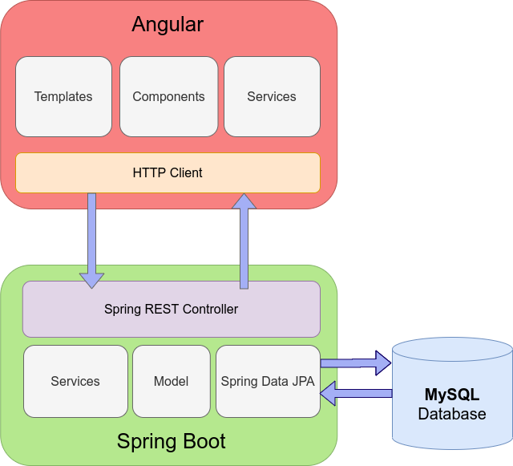
PROJECT ARCHITECTURE

Slide 11
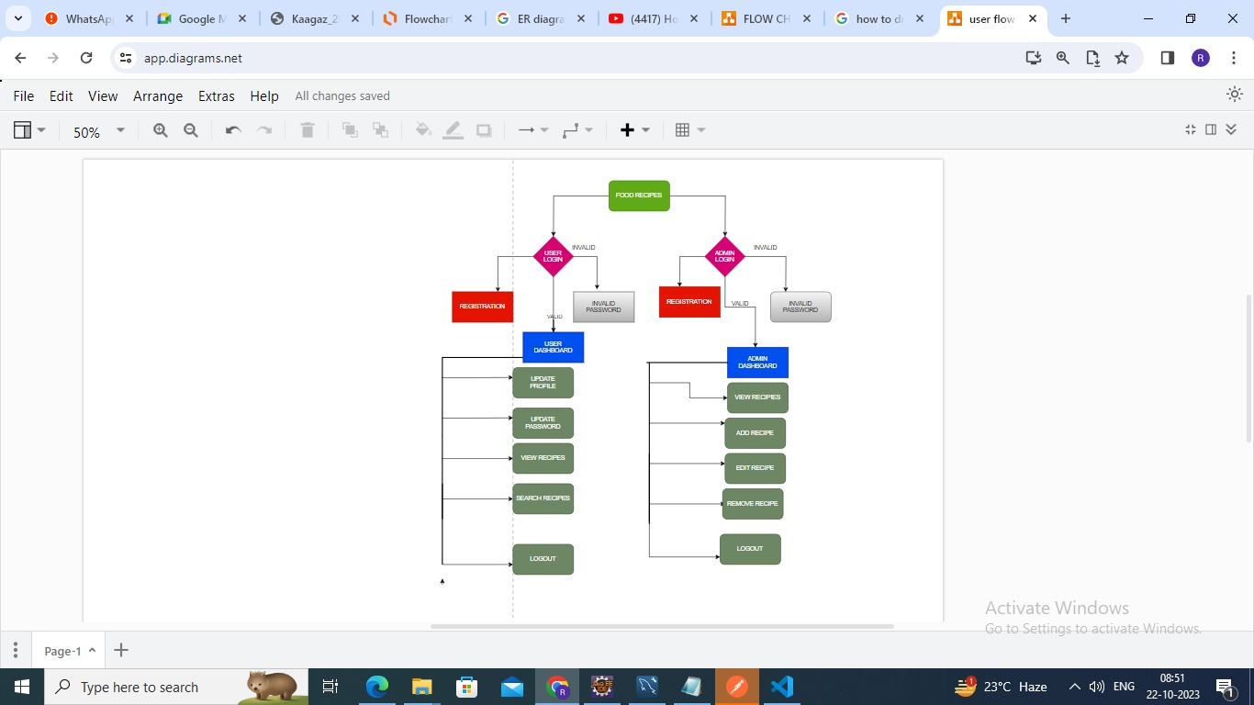
FLOW CHART FOR FOOD RECIPE

Slide 12
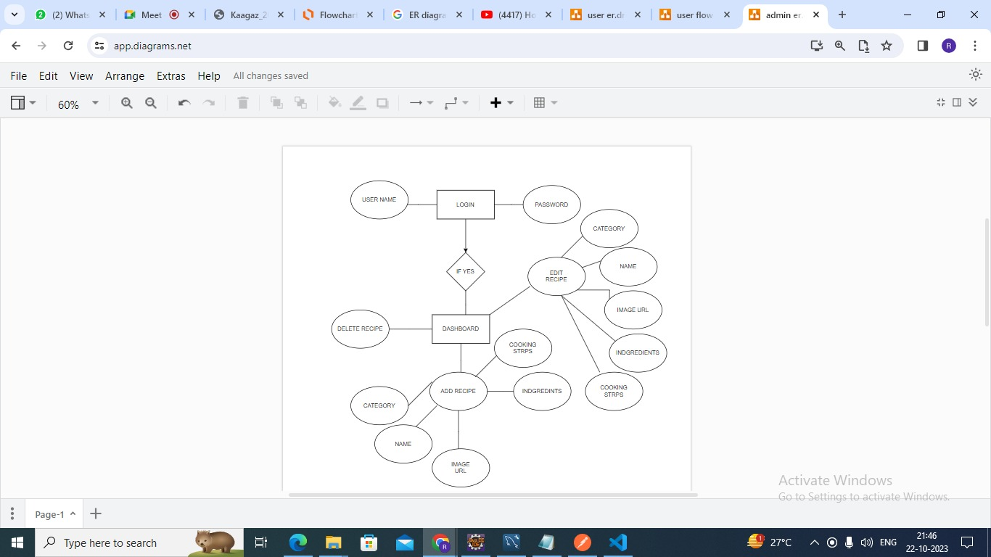
ER DIAGRAM FOR ADMIN

Slide 13
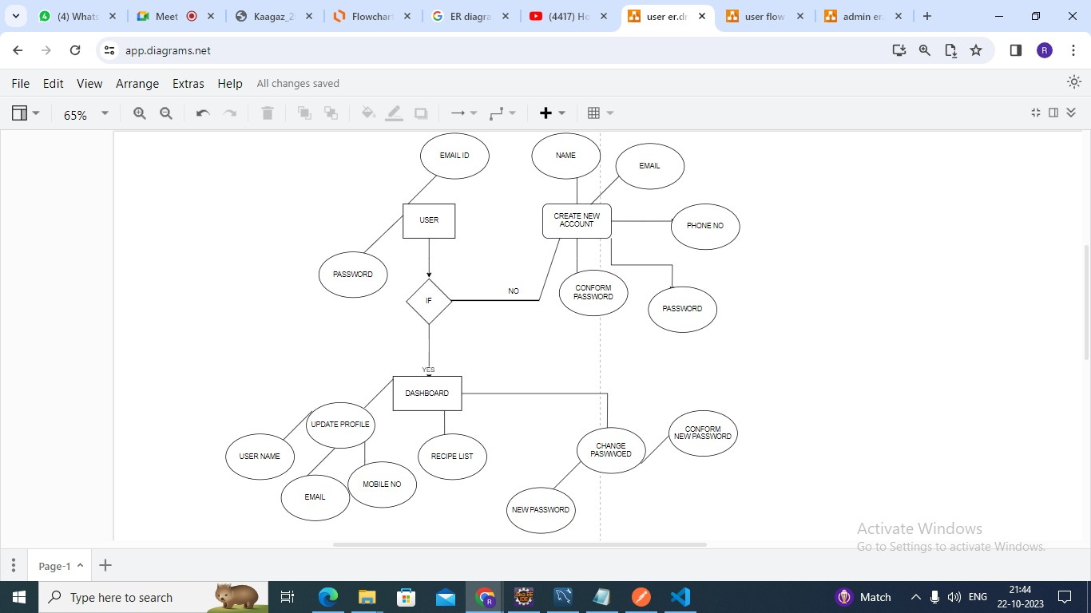
ER DIAGRAM FOR USER

Slide 14

ADVANTAGES
Search for recipes based on the
search keyword like item name,
item description. User will be able to sort
results based on different
categories of the food items.
It ensures the privacy of the
users data and secures its access
in the database and the
maintenance of the application is also easy.

Slide 15
LANDING PAGE
The landing page contains two buttons
The Admin Log-In button
The User Log-In button
One can move to the next pages by clicking on the log in buttons either as a user or admin accordingly.

Slide 16
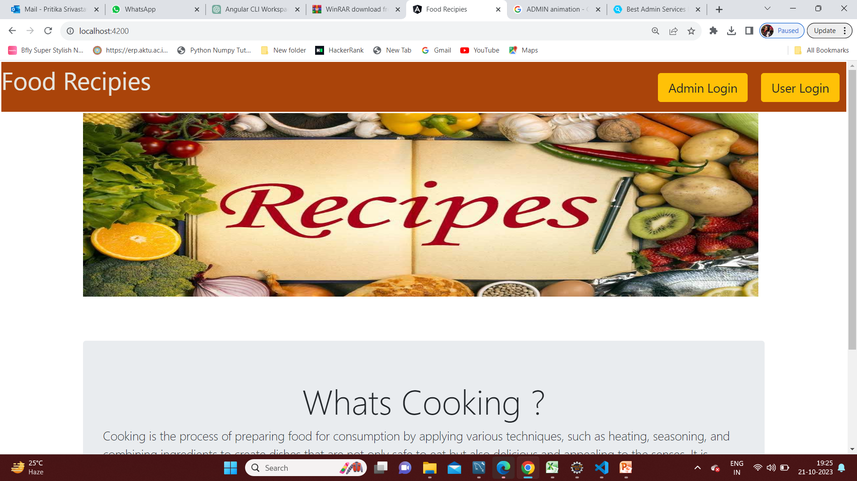
LANDING PAGE

Slide 17
ADMIN LOGIN
The admin login page contains the two boxes
One for User name
Other for password
After providing the username and password one can click on Log-In button and move to the next page that is admin portal
If the there is any mistake in username , password and if the boxes left empty it will show the error and the log-in would be unsuccessful.

Slide 18
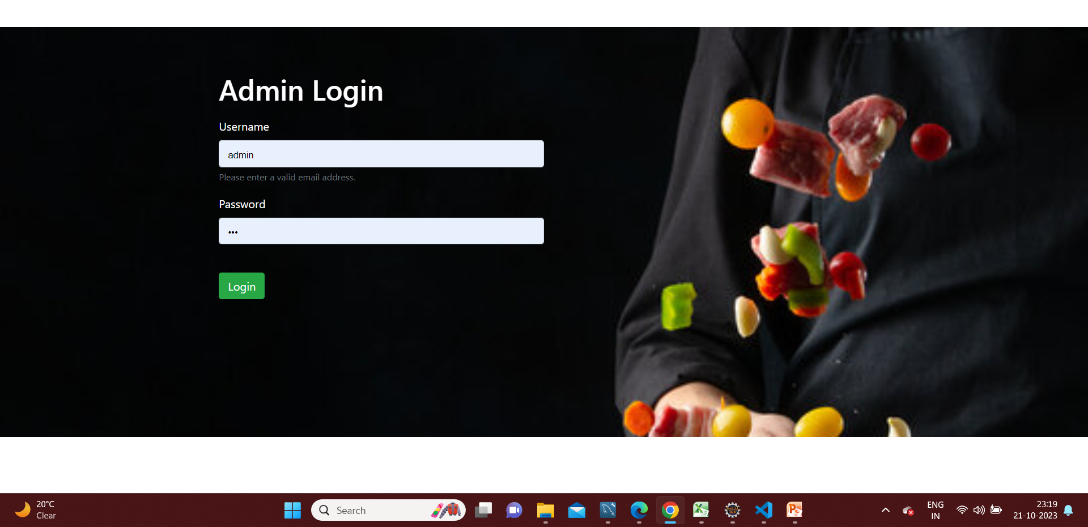
ADMIN LOGIN

Slide 19
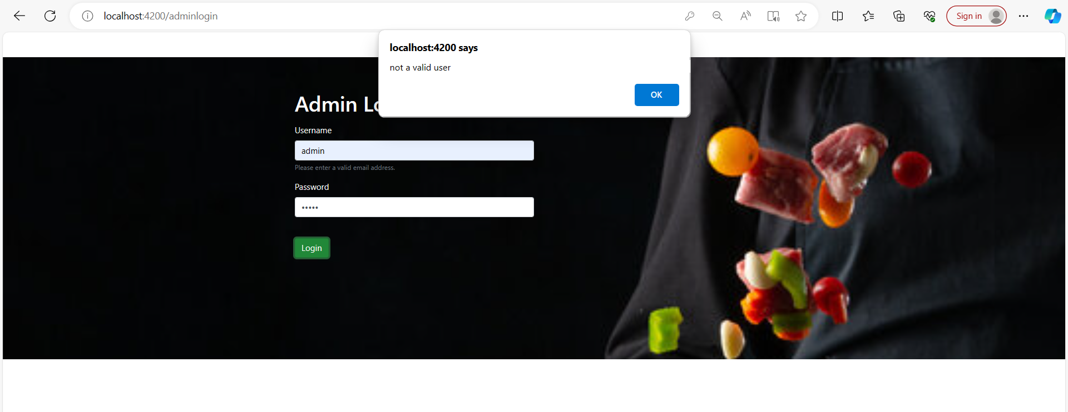

Slide 20
ADMIN DASHBOARD
After log-in successfully into admin portal it will take to this page that is Food Recipe Inventory
Which contains a table which containing the id , image, category (of dish) , actions
The actions column include two buttons
The edit button and delete button
On clicking the edit button one can make changes in the recipe
On clicking the delete button one can delete the recipe it will be deleted permanently.
It also contain an add option on which can be clikced and can be used to add the new recipes .

Slide 21
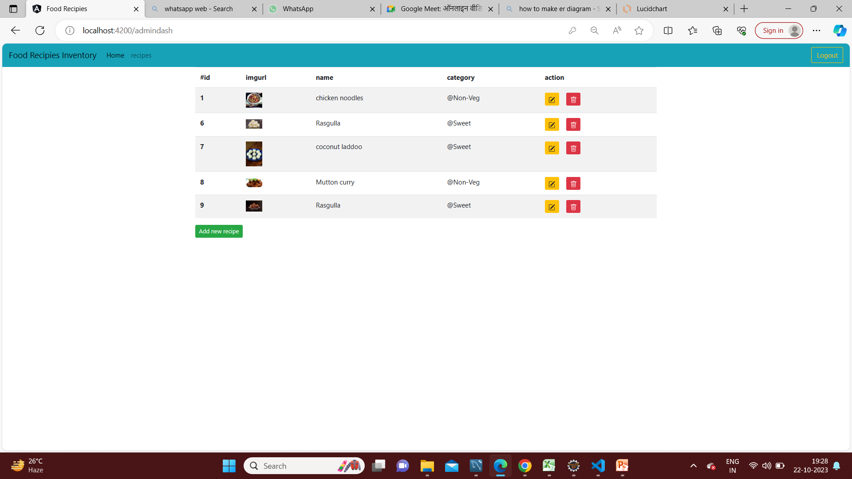
ADMIN DASHBOARD

Slide 22
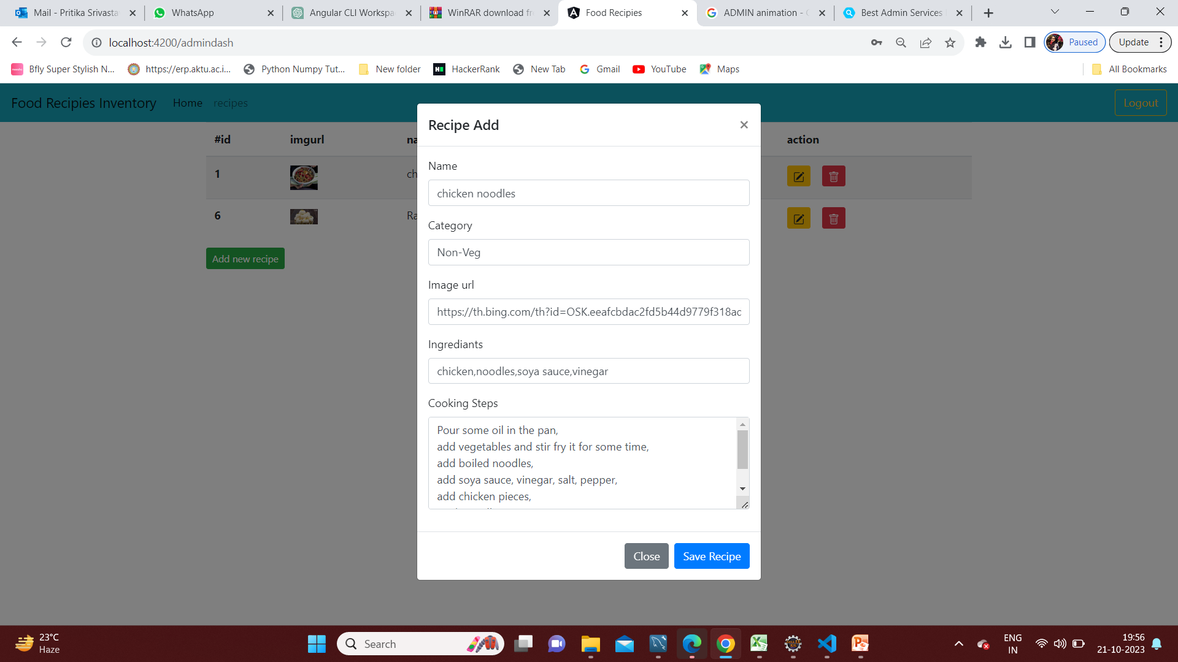
ADD RECIPE

Slide 23
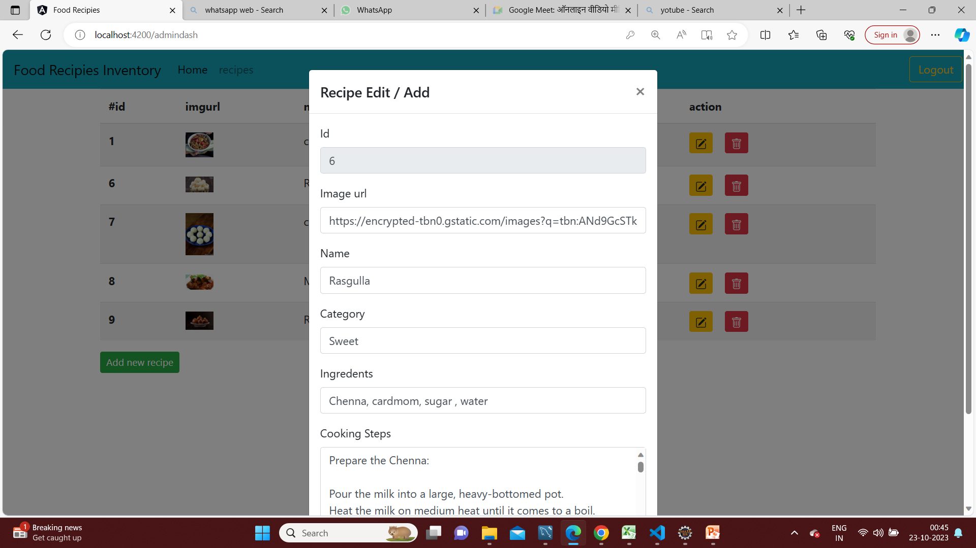
EDIT RECIPE

Slide 24
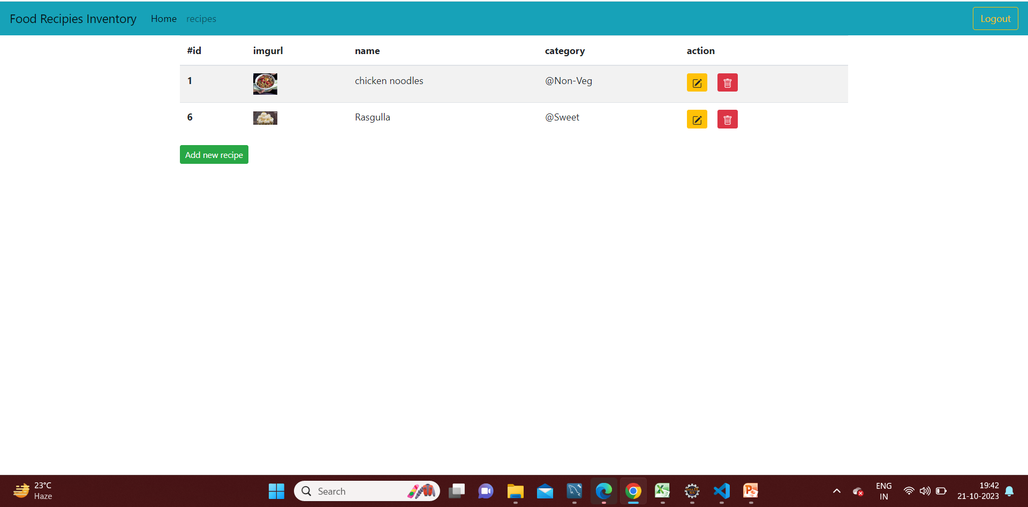
DELETE RECIPE

Slide 25
USER LOG-IN
This page contains two boxes one for Username/userId
The other for Password
Once you provide the correct credentials it will be accessible
On providing wrong credentials it will provide the error “INVALID CREDENTIALS”.

Slide 26
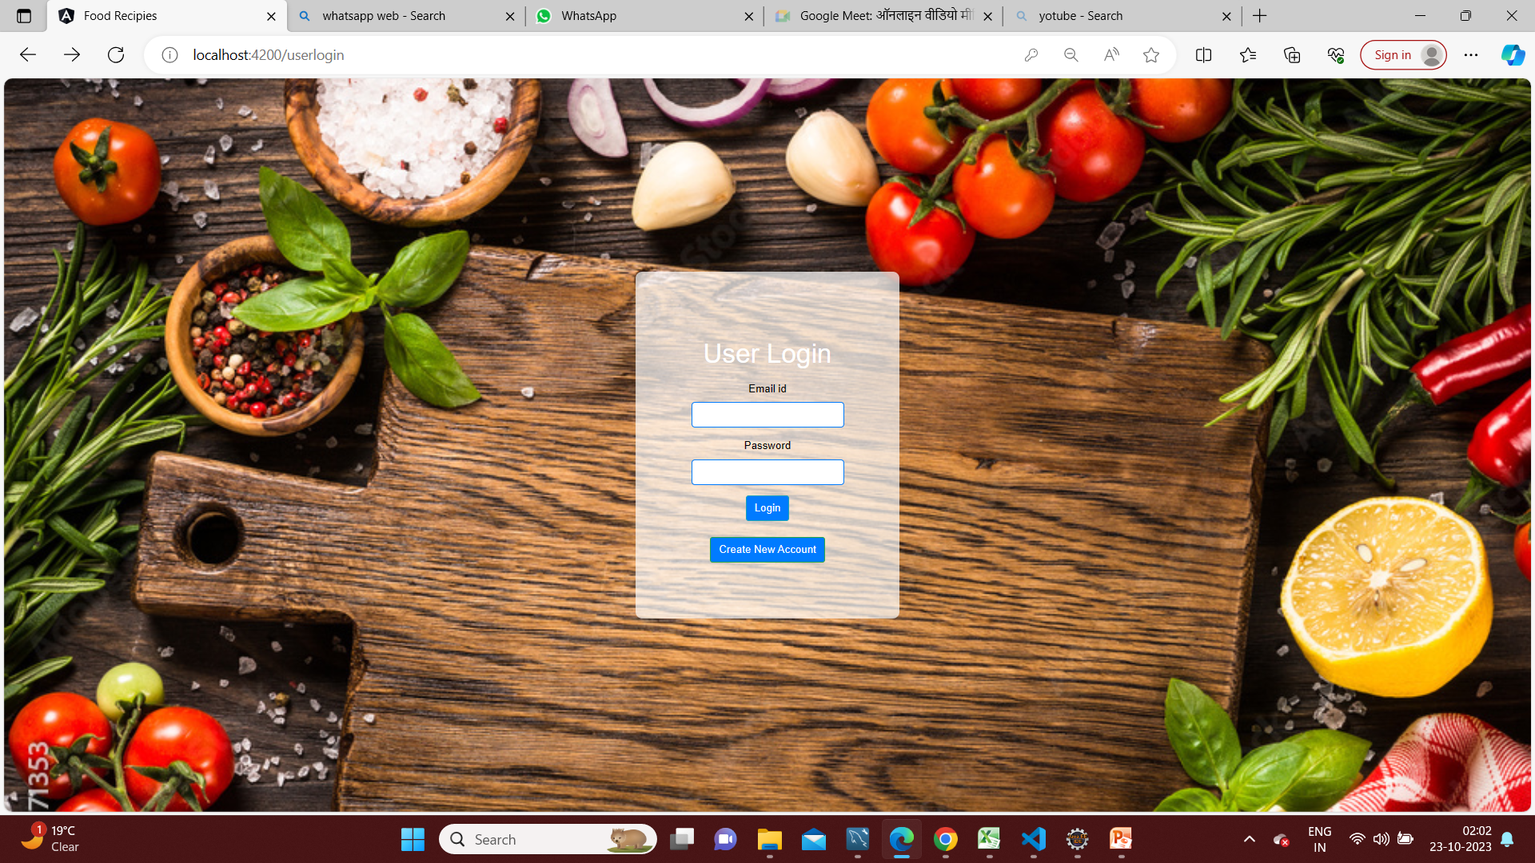
USER LOG-IN

Slide 27
CREATE NEW USER
To create a new user click on the create a new user button
It will prompt a form that will ask about the details of the user and password creation
After providing the details and clicking on submit button it will prompt an alert that user has been created and added
Now the new user can use its credentials and log-in

Slide 28
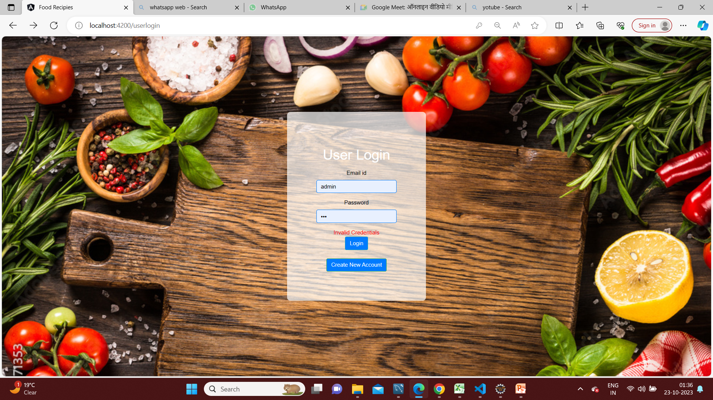
INVALID USER LOG-IN

Slide 29
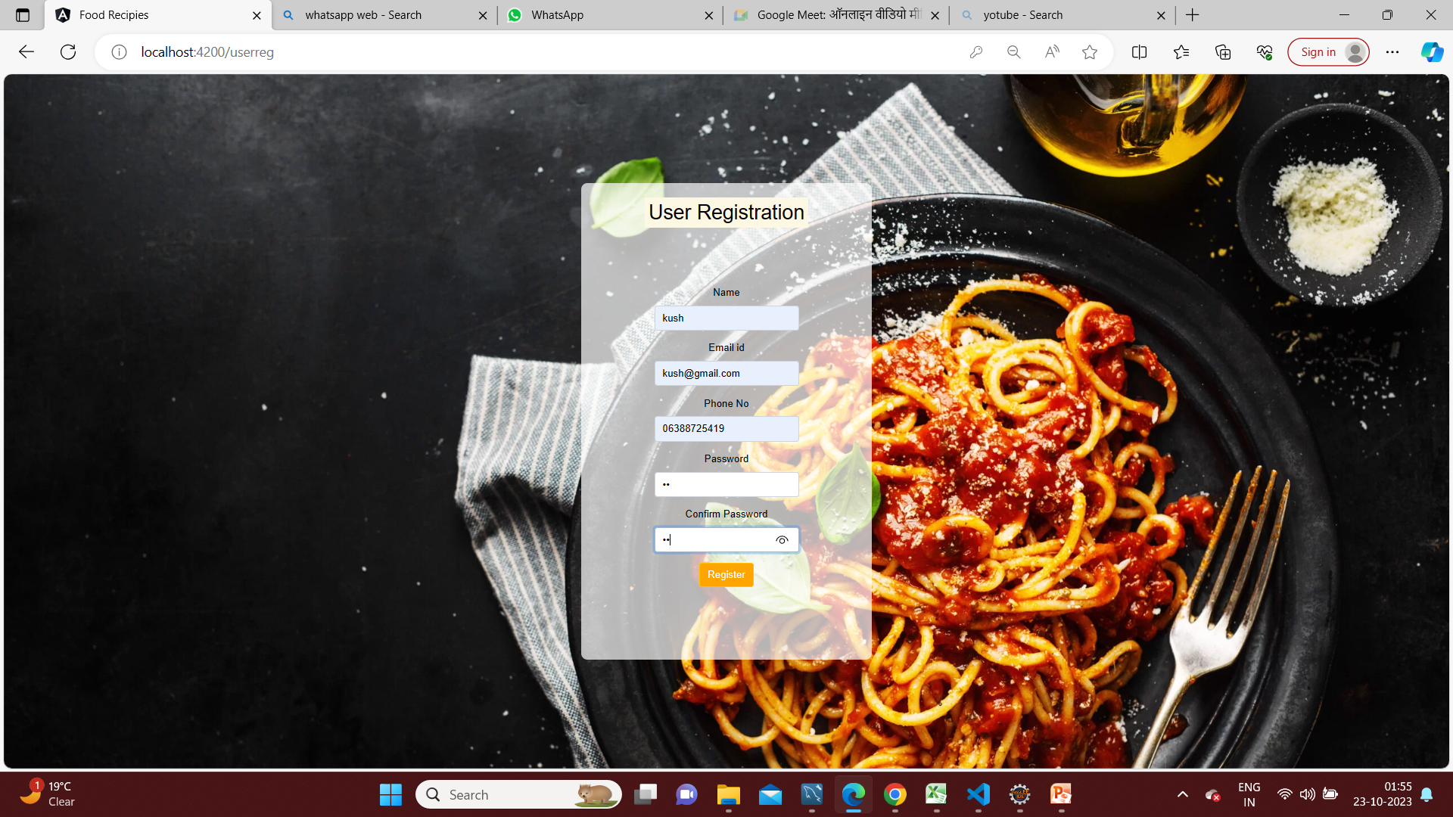
CREATE NEW USER

Slide 30
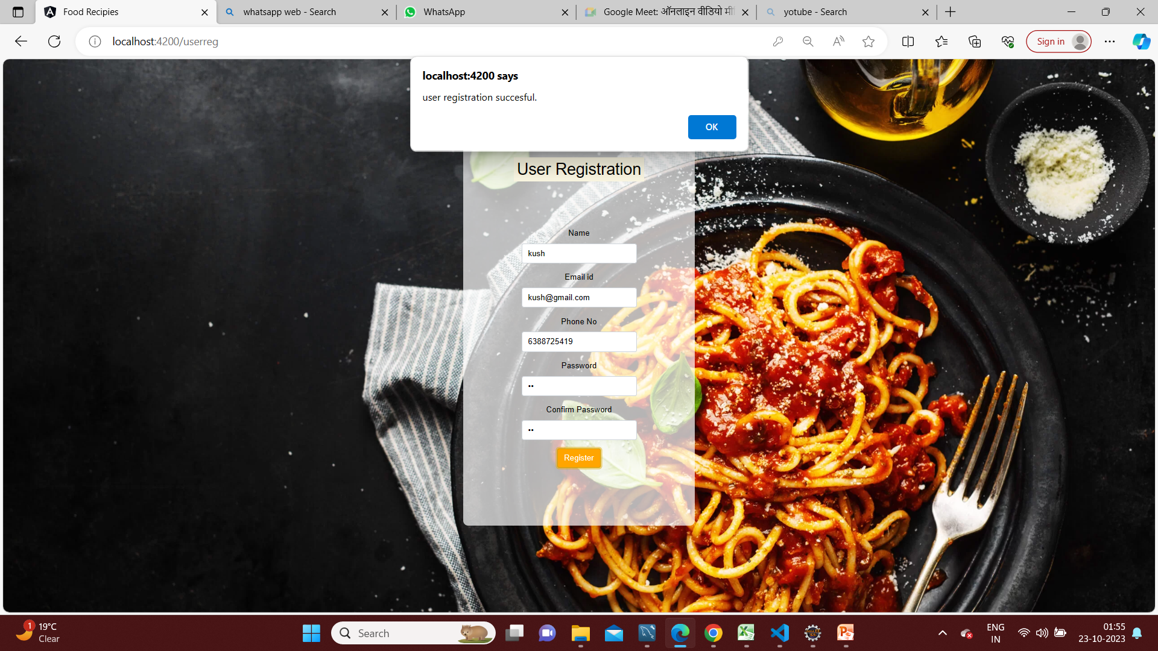

Slide 31
FOOD RECIPE
This pages shows the Recipes with their images
One can click and open the recipes and that they want read about
User can use search option available there to search particular recipe the want to search by writing its category
This page also contains “CHANGE PASSWORD” button
This page also contains “LOG-OUT” button
This page also contains “CHANGE PASSWORD” button
This page also contains “UPDATE PROFILE BUTTON ” button

Slide 32
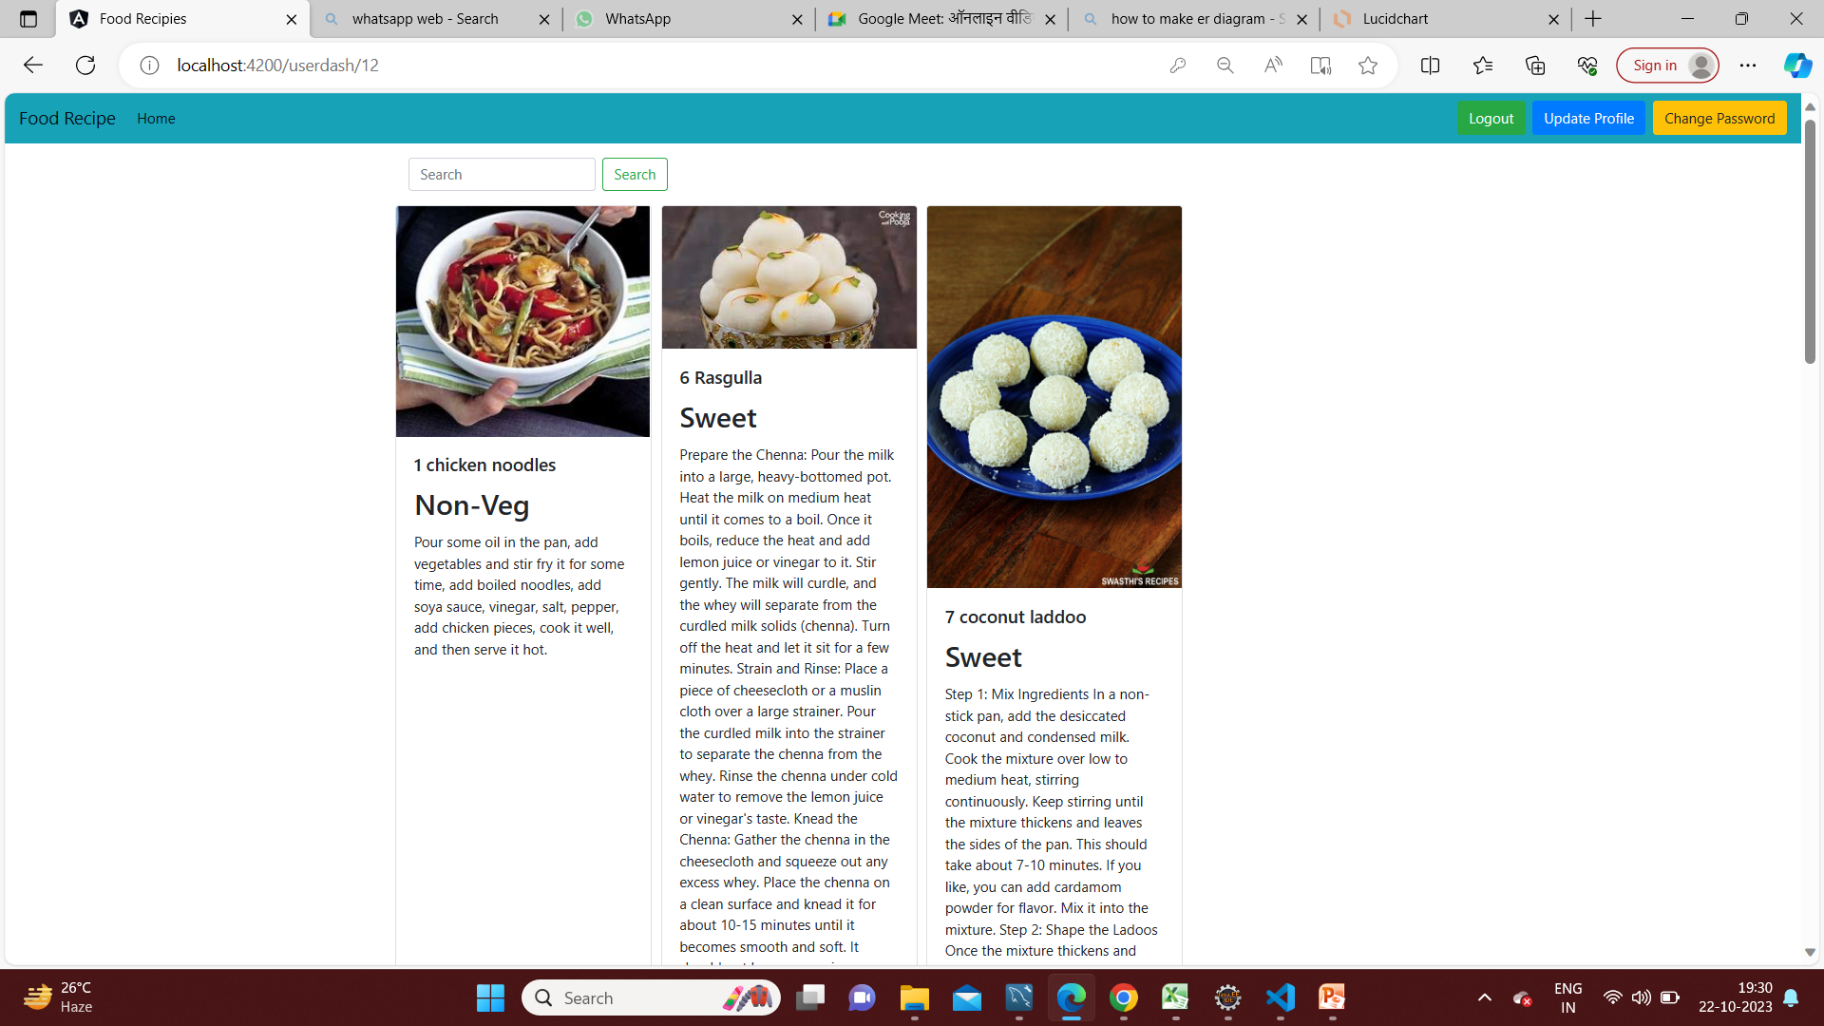
FOOD RECIPE

Slide 33
FOOD RECIPE DETAIL
User can click on any recipe to read the full recipe and learn it .

Slide 34
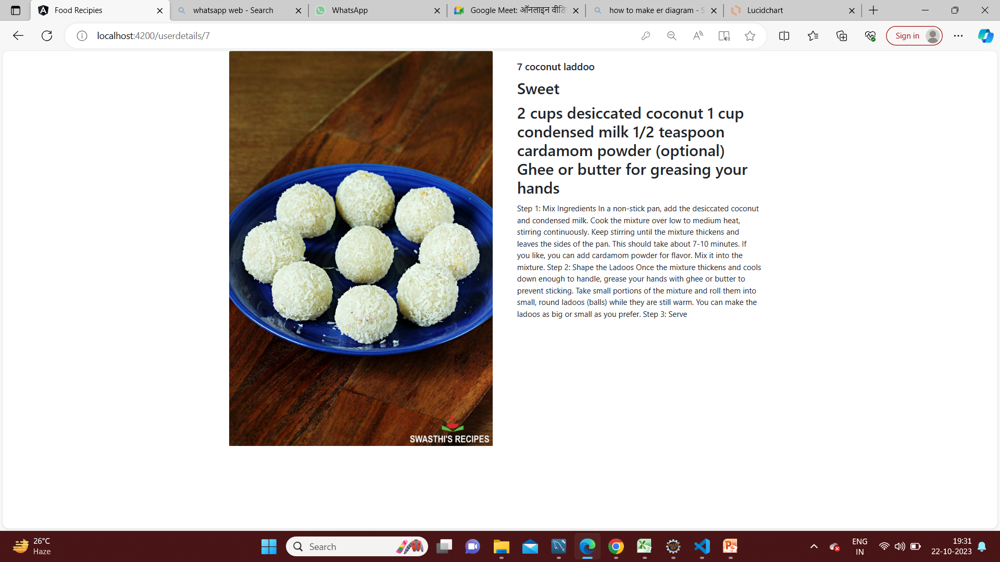
READ RECIPE IN DETAILS

Slide 35
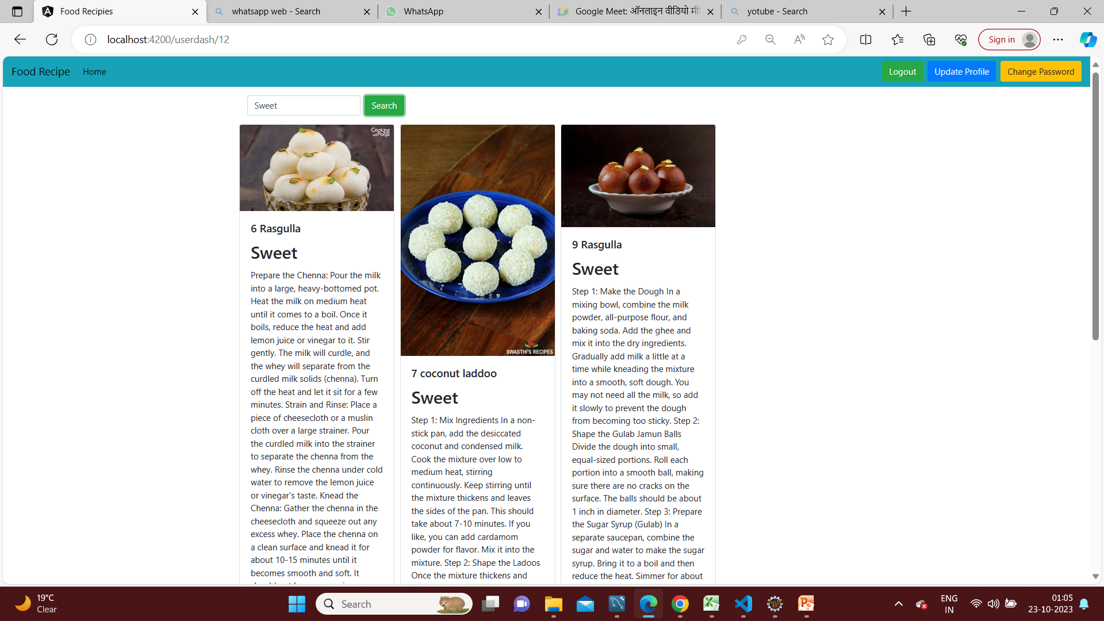
SEARCH RECIPE

Slide 36
CHANGE PASSWORD
The user can update his password from old one to new password
By providing his name , new password and confirming it
For make his profile strong

Slide 37
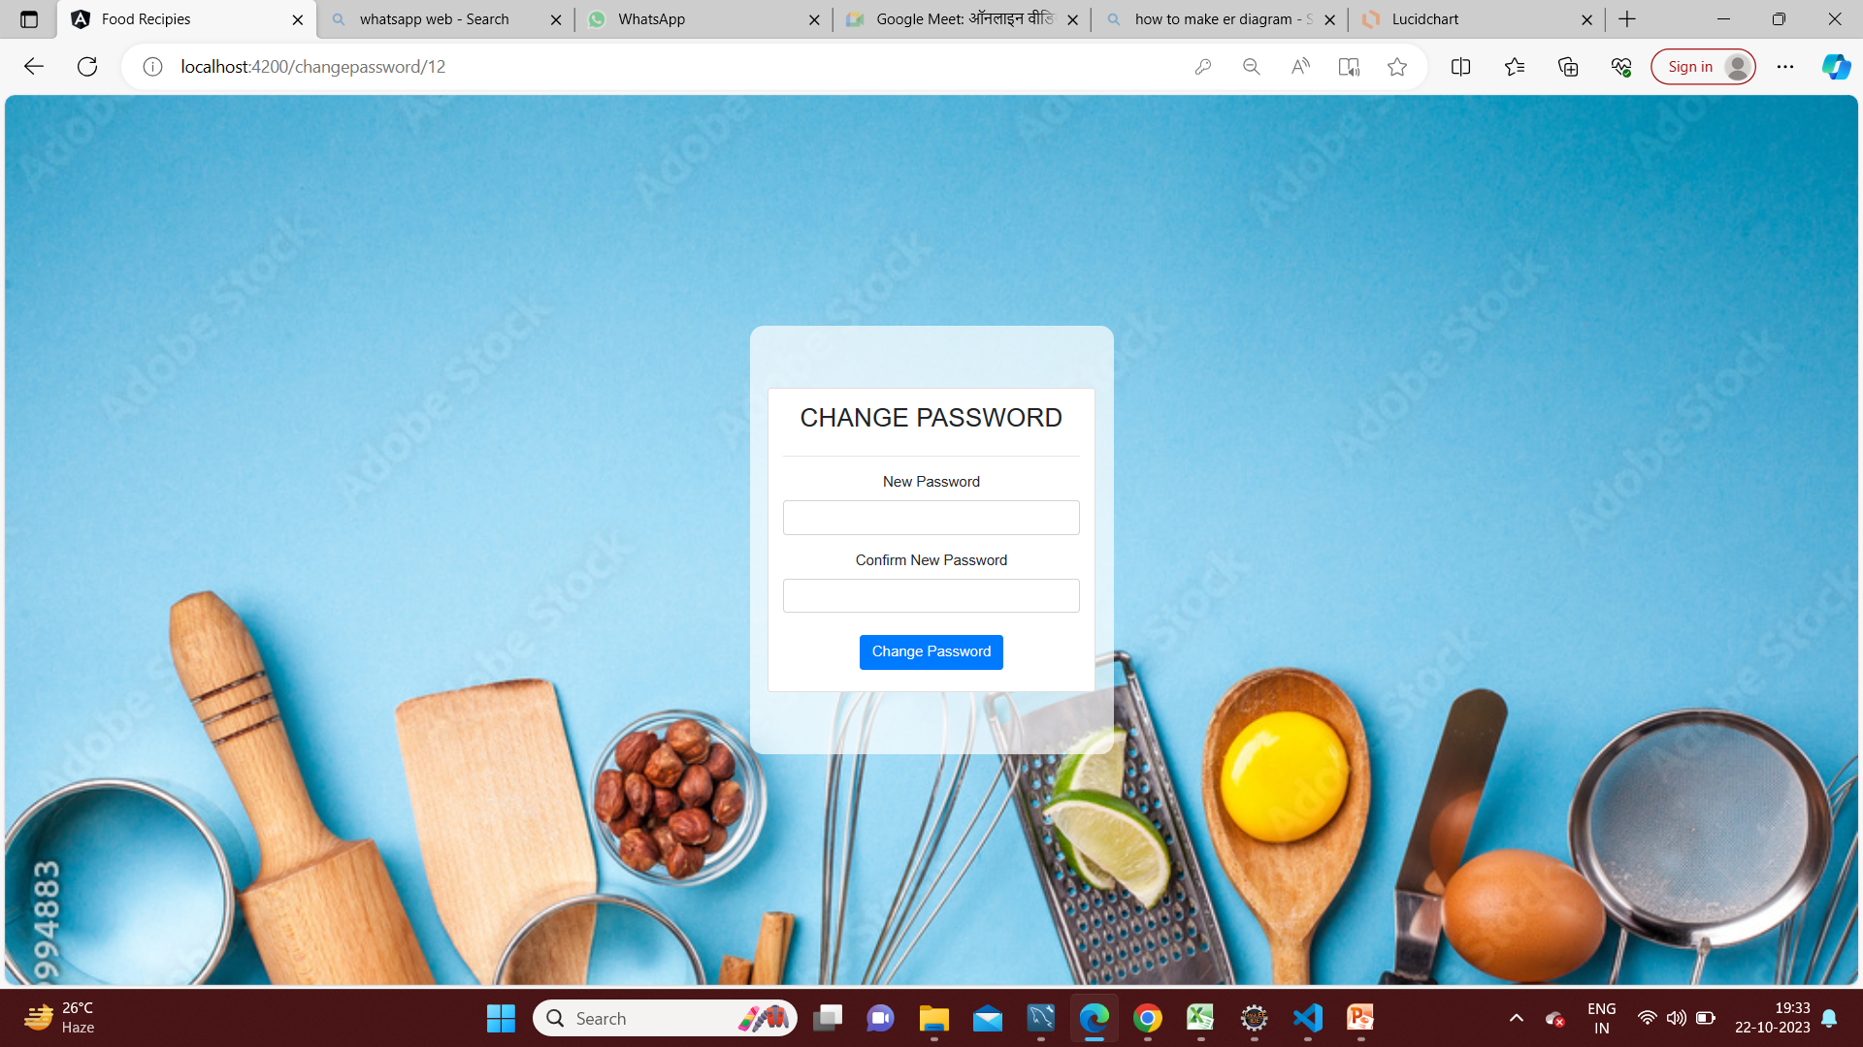
CHANGE PASSWORD

Slide 38
UPDATE PROFILE
User can update his profile by using this option
User can change it by username, email and mobile number
And this is how the profile of user will be updated .

Slide 39
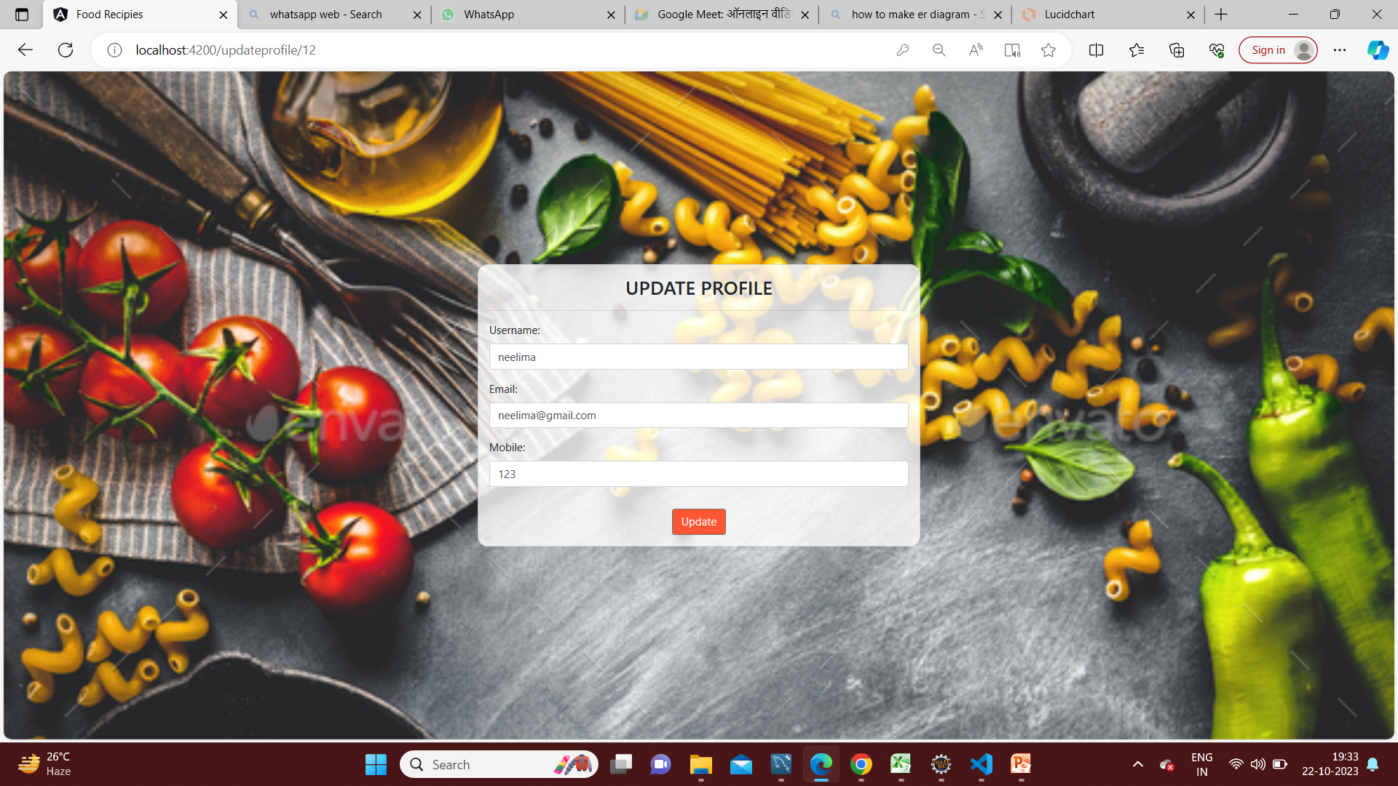
UPDATE PROFILE

Slide 40
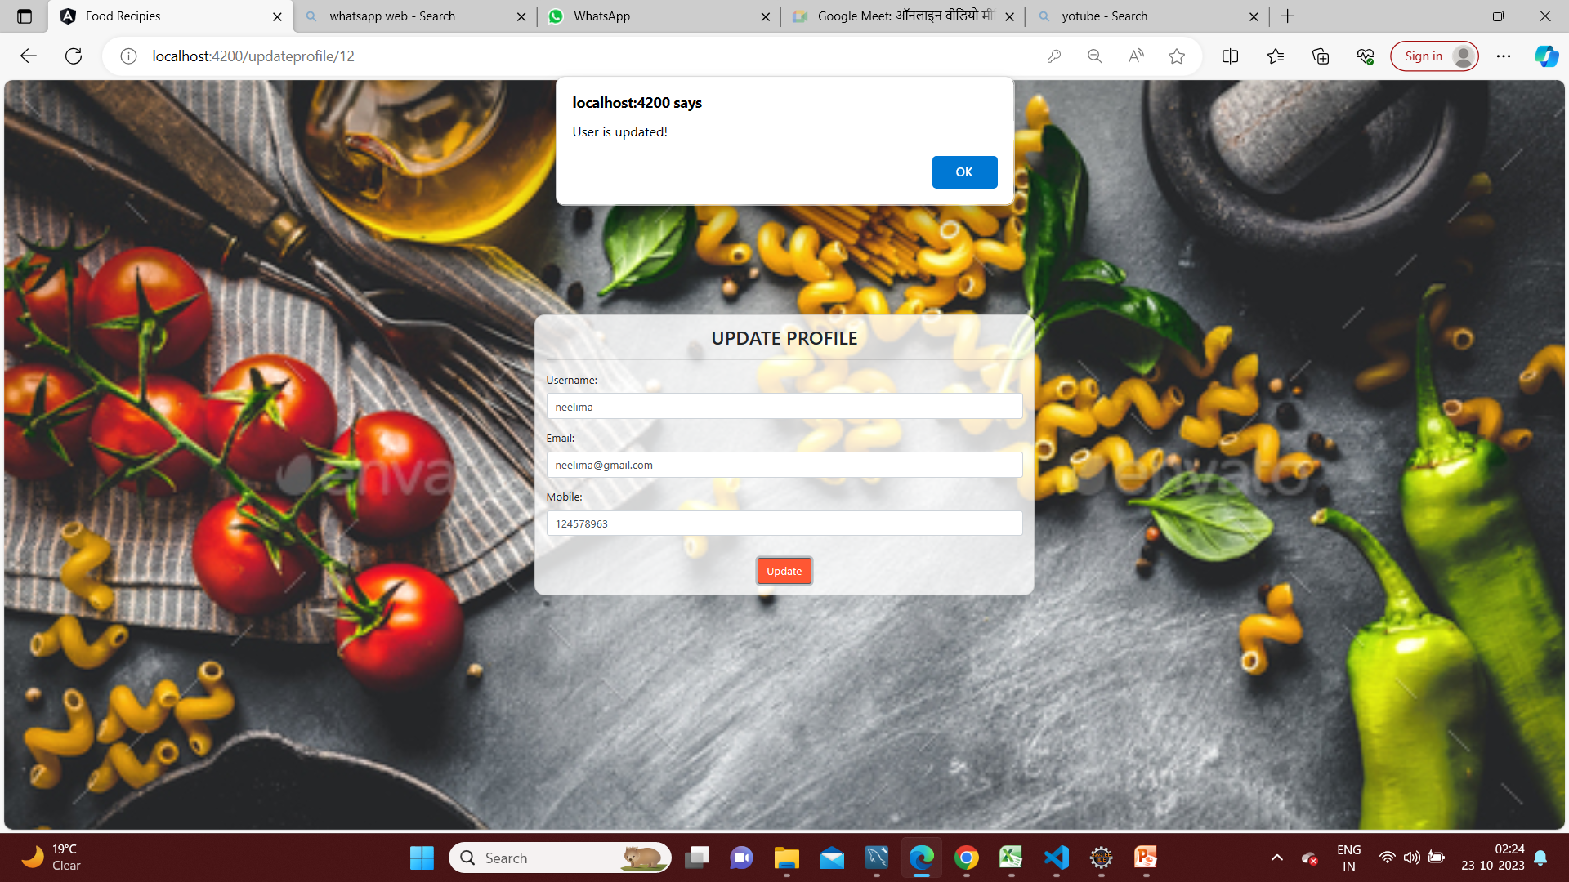

Slide 41
LOG OUT
Log-Out button option is present in the navigation-bar upper side corner one can log-out by clicking on it and will move to the landing page.

Slide 42
LOG OUT

Slide 43
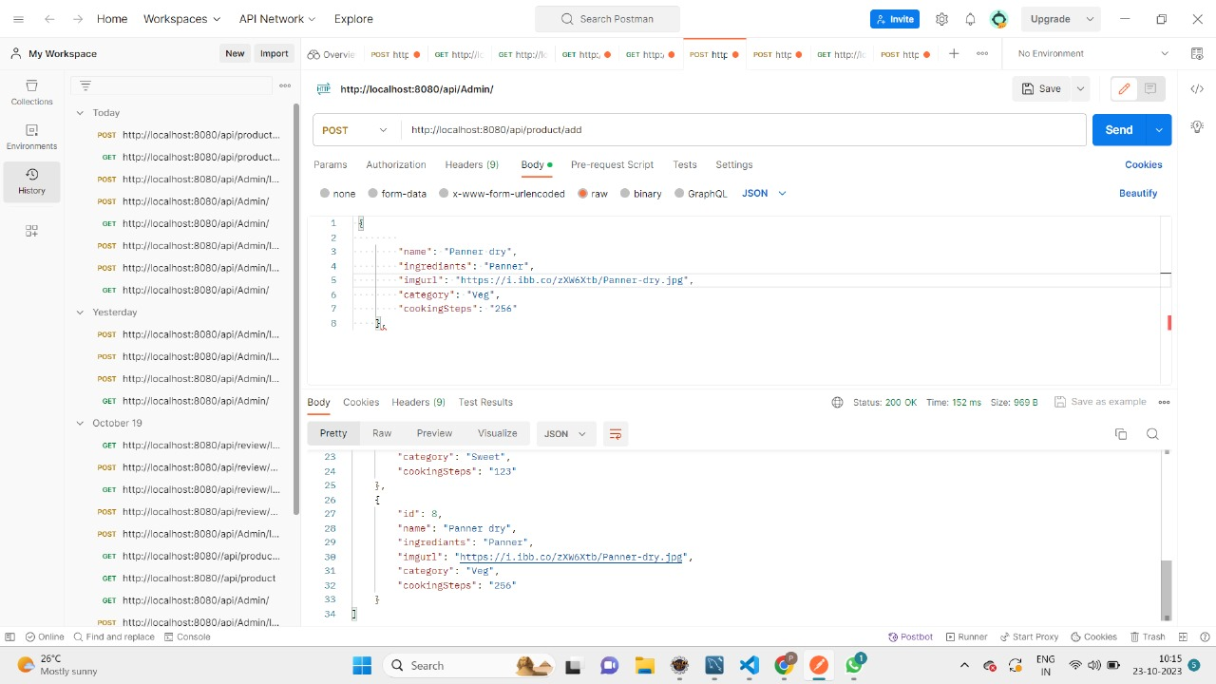
POSTMAN TESTING

Slide 44
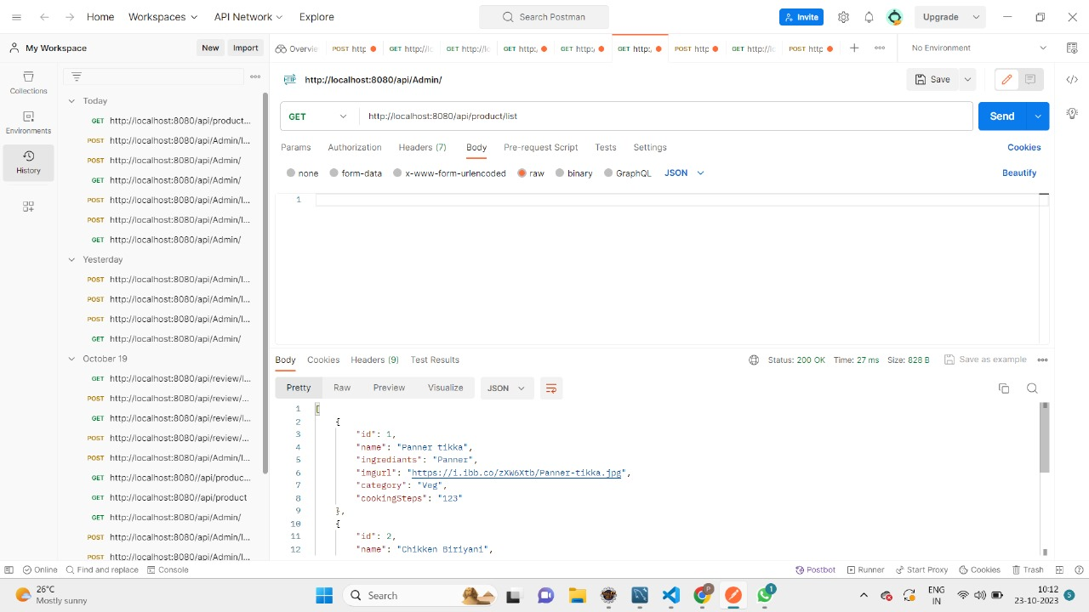

Slide 45
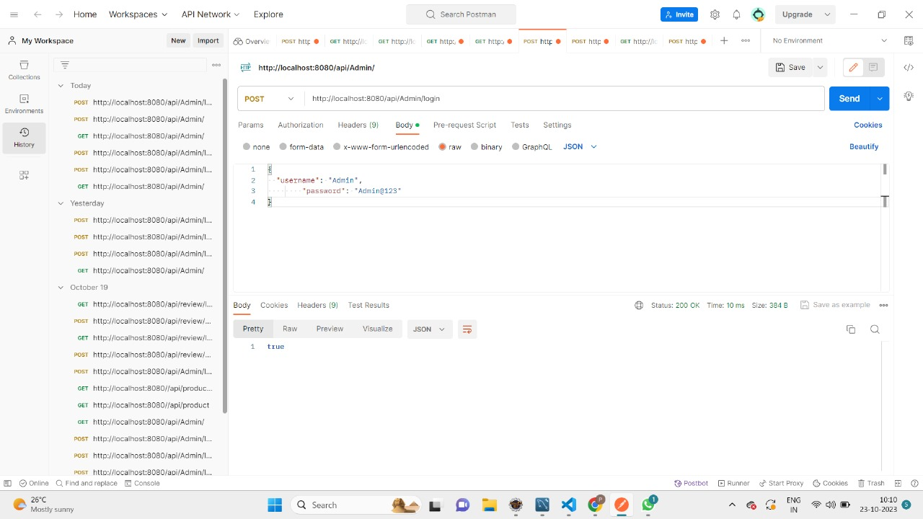

Slide 46
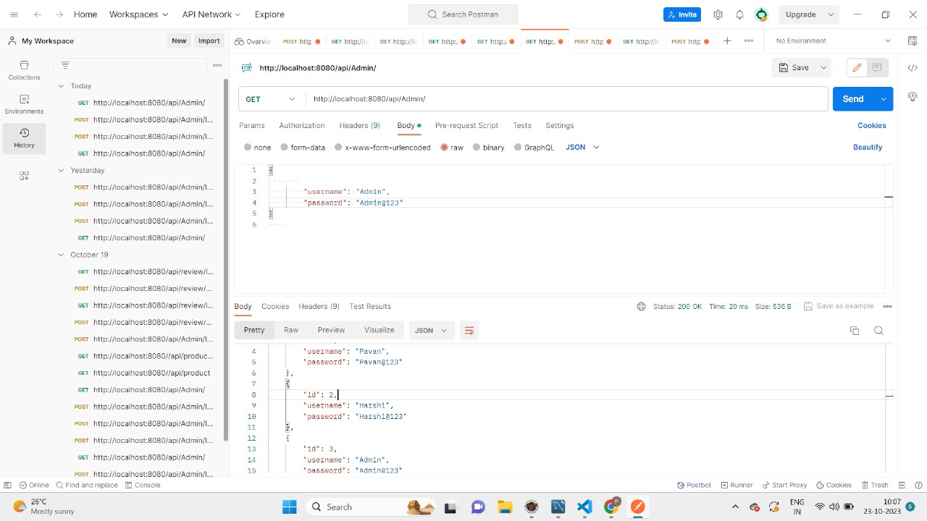

Slide 47
CONCLUSION
The main objective of the application is to understand the concept and implementation of Java, Spring Boot, Databases and Angular technology.
Our project helps the users to easily find out their choice of taste and recipe.

Slide 48
FUTURE SCOPE
Add more user interface feature
Nutrition information
Personalised user profiles
Commercialize the web app

Slide 49


